Slide 1

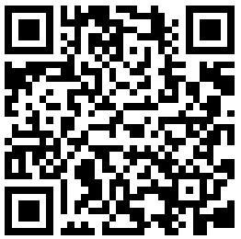
CS2113/T – Lecture 6
* Go to:
github.com/nus-cs2113-AY2021S2/TaskStream
Fork to your GitHub account
Clone the fork to your computer
Set up the project in IDE
Also, join the session: http://pollev.com/anarayan
There is a pollEv question towards the end of the lecture
This lecture will be recorded
This lecture will be recorded
Archipelago session
* Reused from previous semester

Slide 2

Recap
Requirements – gathering & specifying
Collections & Generics
Managing merge conflicts
More on code quality – safe practices

Slide 3
Q: User stories don’t capture non-functional requirements
False

Slide 4
Activity: working with Deadlines
Run Main::main
Observe how printDeadlines and countDeadlines work

Slide 5
Q: We can sense casting in (relation to) this code snippet
A: Yes
public static void printDeadlines(ArrayList<Task> tasksData) {
for (Task t : tasksData) {
if (t instanceof Deadline) {
System.out.println(t);
}
}
}

Slide 6
Java – Stream
High level overview only!
Sequence of elements from a source that support aggregate operations
Content based on: https://www.oracle.com/technical-resources/articles/java/ma14-java-se-8-streams.html

Slide 7
Java – Stream
Sequence of elements from a source that support aggregate operations
Not stored;
computed on demand

Slide 8
Java – Stream
Sequence of elements from a source that support aggregate operations
Data provider
Collections, I/O …

Slide 9
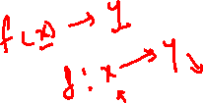
Java – Stream
Sequence of elements from a source that support aggregate operations
Functions
filter, map …

Slide 10
Stream vs Collection
Both allow working with a sequence of elements
… difference is when they compute things
Collections – in memory (compute and store)
Streams – fixed data compute on demand

Slide 11
Stream vs Collection
Both allow working with a sequence of elements
… difference is when they compute things
Collections – in memory (compute and store)
Streams – fixed data compute on demand

Slide 12
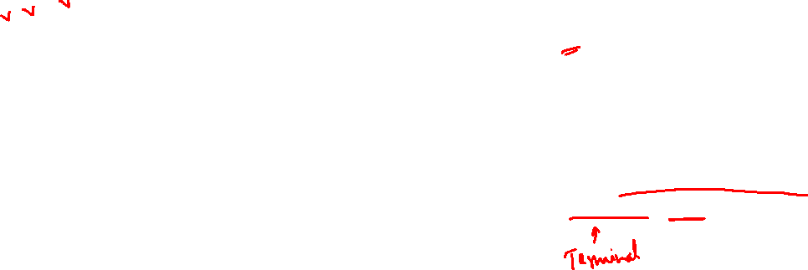
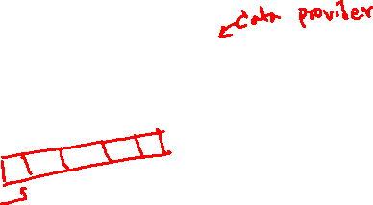
Stream vs Collection
Iteration done by the programmer – external iteration
List<String> transactionIds = new ArrayList<>();
for(Transaction t: transactions){
transactionIds.add(t.getId()); }
Internal iteration
List<Integer> transactionIds = transactions.stream()
.map(Transaction::getId)
.collect(toList());

Slide 13
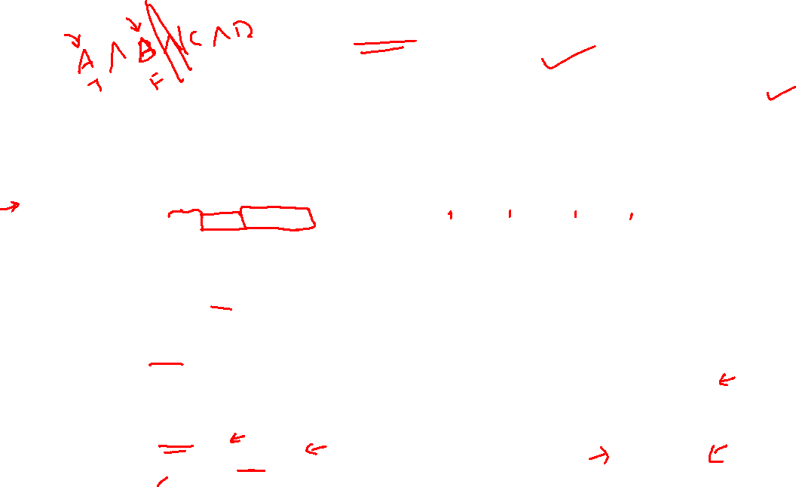
Pipeline
Lazy evaluation
Short-circuiting
Chaining operations
Operations done one after the other; return streams
List<Integer> numbers = Arrays.asList(1, 2, 3, 4, 5, 6, 7, 8);
List<Integer> twoEvenSquares =
numbers.stream()
.filter(n -> {
System.out.println("filtering " + n);
return n % 2 == 0;
})
.map(n -> {
System.out.println("mapping " + n);
return n * n;
})
.limit(2)
.collect(toList());
Each operation returns a stream
filtering 1
filtering 2
mapping 2
filtering 3
filtering 4
mapping 4

Slide 14
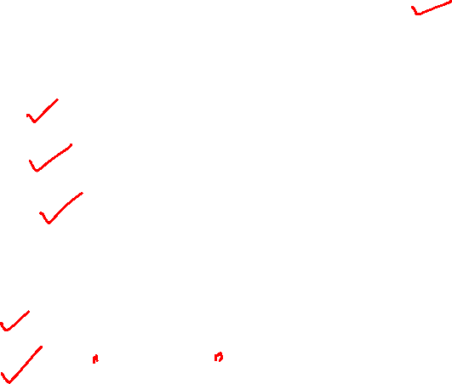
Activity: print deadlines and count using stream
Create a branch “streams”
Add code to use streams to print tasks
Add code to print deadlines using stream
Add code to count the number of deadlines using stream
Commit code to branch: streams
Push streams branch to your fork
git push –u origin streams

Slide 15
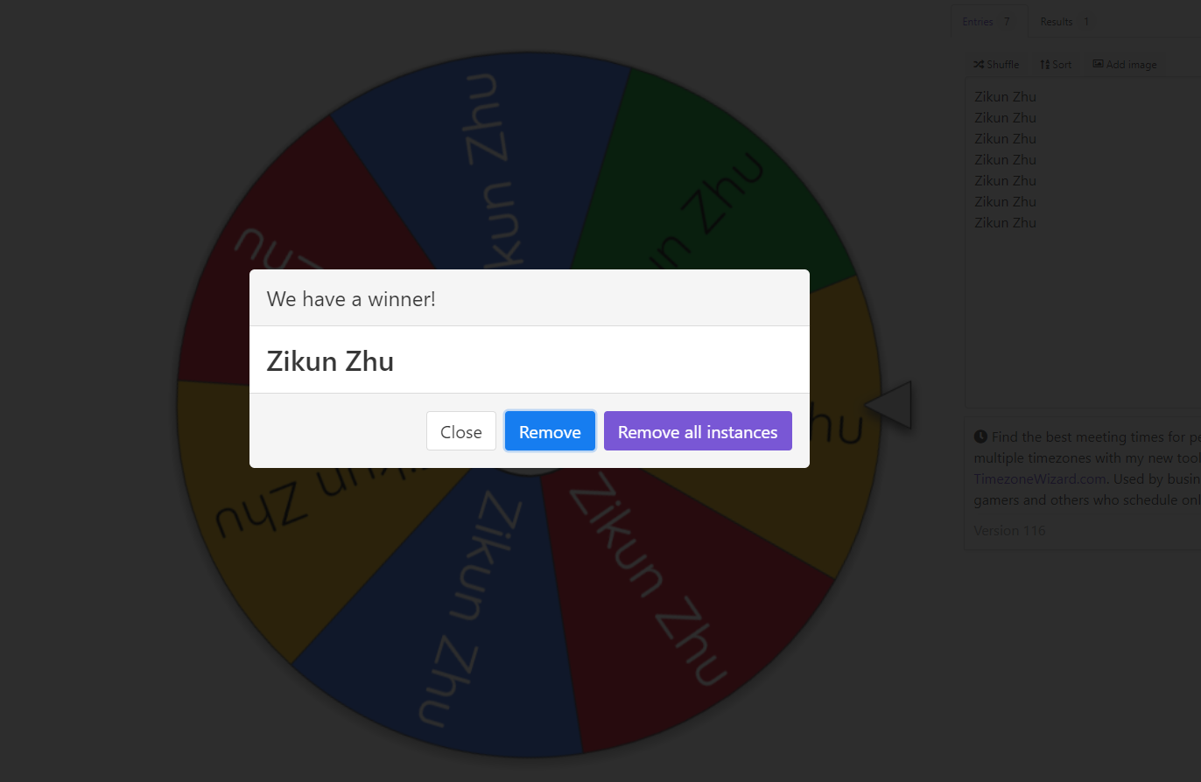
Spin the wheel

Slide 16
Lambdas
Anonymous functions
can be passed to other objects/methods

Slide 17
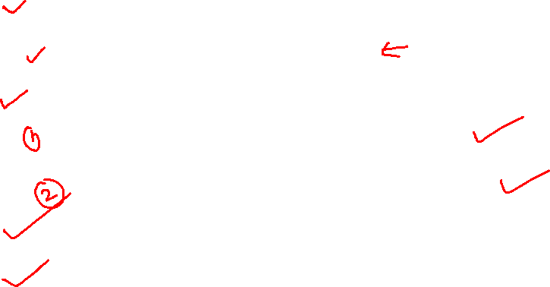
Activity: filter tasks by some string
Observe how you print deadlines using stream
Checkout master branch
Create a branch “lambdas”
Print deadlines in sorted order
Add code to filter task by a string
Commit code to branch: lambdas
Push lambdas branch to your fork
git push –u origin lambdas

Slide 18
Activity: Create PR1
On your github fork:
Create PR to your master branch from streams branch
Merge PR on GitHub

Slide 19
Q: Merge conflicts can occur when: (select the most suitable option)
changes happen at different locations in the codebase
git can merge all the changes
git cannot create a fast forward merge
team members don't like each other
a developer deletes a file while others were modifying it
✓

Slide 20
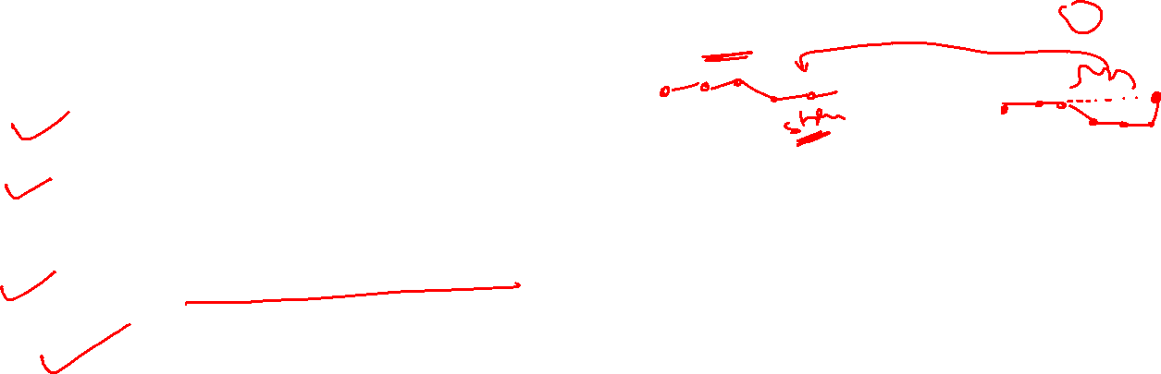
Activity: Create PR2
Checkout master on your local
Pull (from your github repo) your master
Merge master to lambdas (on your local)
Resolve merge conflicts (on your local)
Push changes to lamdbas branch
Create PR to your master from lambdas branch (on github)
git checkout master
git pull
git checkout lambdas
git merge master
git push origin lambdas

Slide 21
Revision control workflows

Slide 22
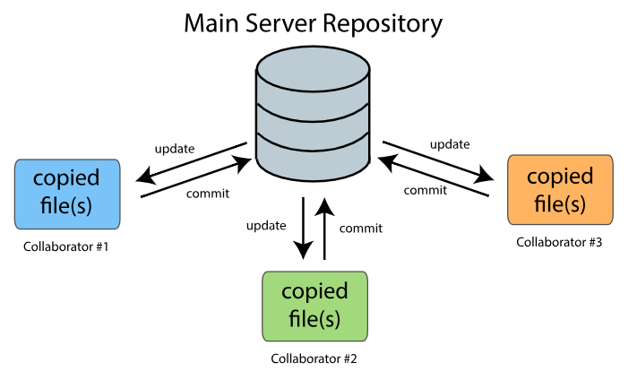
CRCS vs DRCS

Slide 23
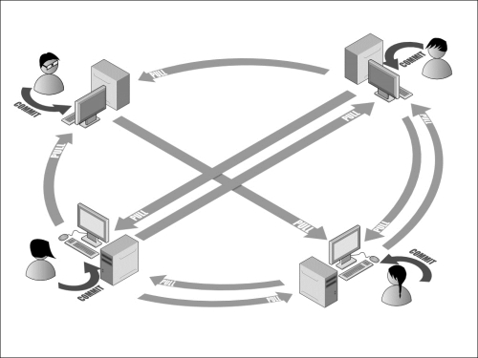
CRCS vs DRCS

Slide 24
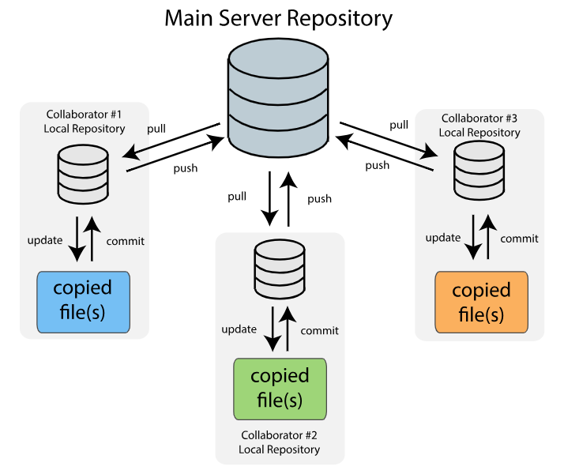
CRCS vs DRCS
Git
Mercurial
Bazaar

Slide 25
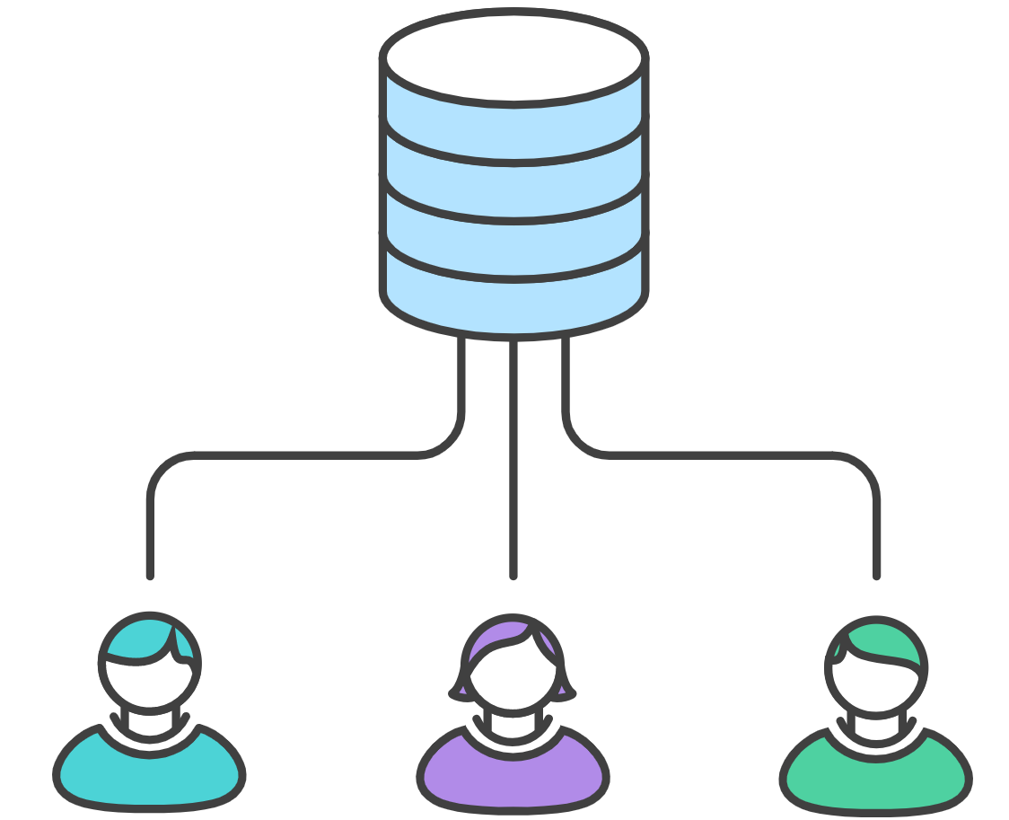
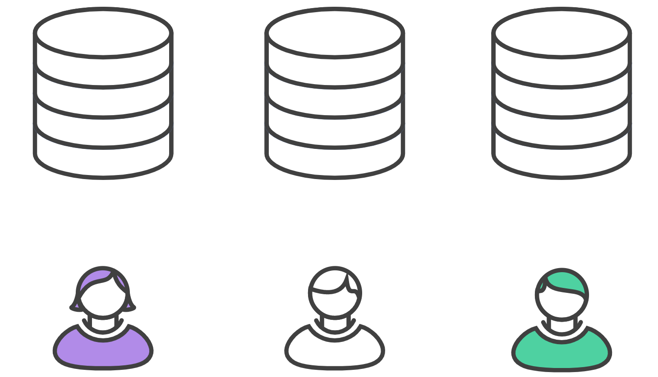
Workflow: Centralized vs Forking

